Slide 1
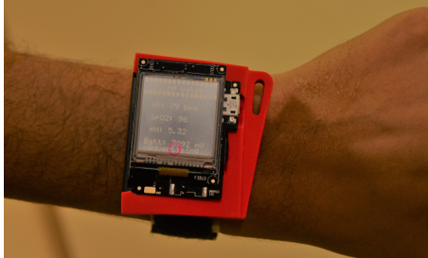

pH Watch - Leveraging pulse oximeters in existing wearables for reusable, real-time monitoring of pH in sweat
Ananta Narayanan BALAJI
2ND YEAR pHD Student
ADVISED BY PROF. Li-shiuan PEH¹ and PROF. SHAO HUILIN²
¹Department of COMPUTER SCIENCE, NUS
²MULTI-SKILLS MOLECULAR DIAGNOSTICS LAB, NUS
[Ananta Narayanan Balaji¹, Chen¹, Wang, Peh and Shao, Mobisys 2019]
Notes:
Hello Everyone. I’m here to talk about pH Watch. This work has been done with my colloborators Chen Yuan, Wang Bo, Prof. Li-Shiuan and Prof. shao Huilin. We are all from National University of Singapore.

Slide 2
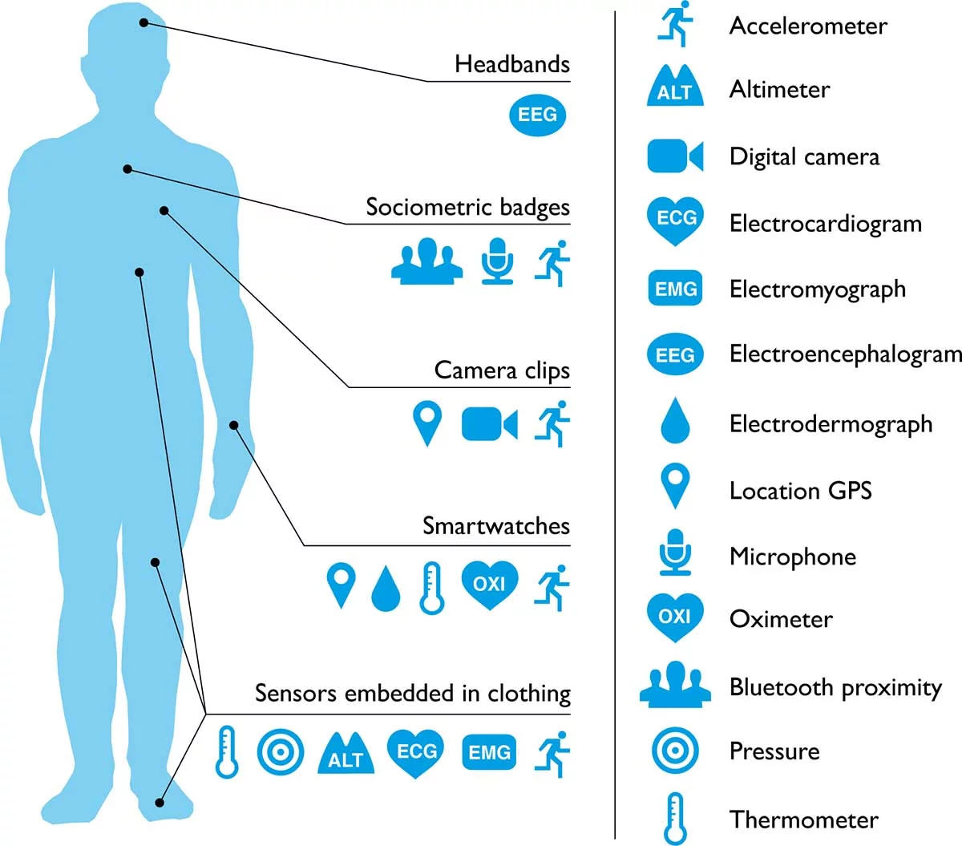
Wearables for human health sensing
19 million fitness devices are likely to be sold this year, that number is predicted to grow by USD 50 Billion in 2022
Image Source : https://reliawire.com/wearable-technology-health/
Notes:
Wearables are being everyone nowadays, Most of us have fitness/trackers for sensing heart rate. There are also a lot of products such as head bands,

Slide 3
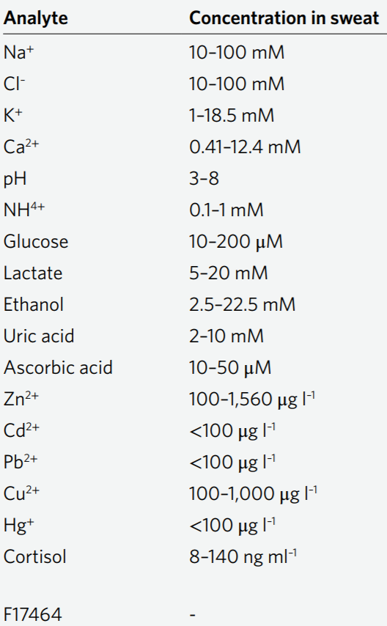
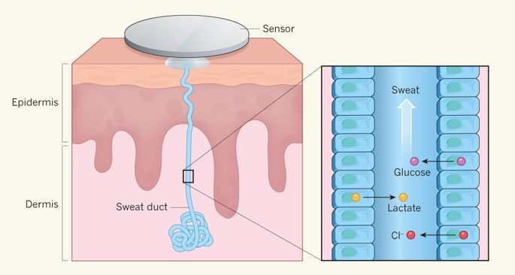
Why sweat Sensing ?
Sweat contains a wealth of biomolecular information
Non-invasive while compared to blood tests
Sweat is very easily accessible
Image Source : https://www.nature.com/articles/529475a?draft=collection&proof=true&platform=oscar
Notes:
In recent days, There has been lot of works on sensing biomarkers from sweat.
Easily available valuable bio fluid
Contains a lot of useful biomarkers such as sodium, Potassium, Chloride , Glucose, pH etc.
Can be obtained very easily.
Analysis of sweat is very non-invasive. As opposed to invasive blood tests.

Slide 4
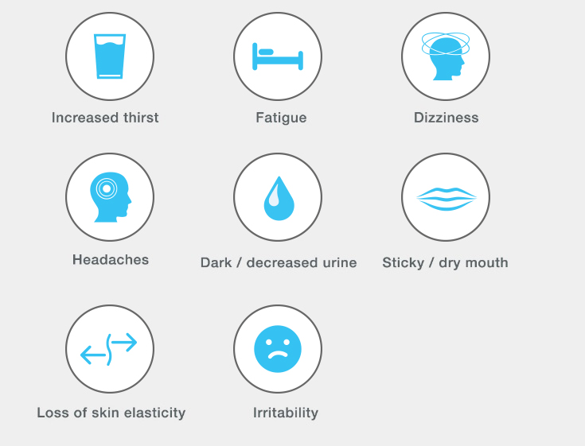
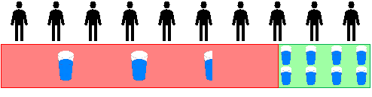
pH value of sweat
Under a dehydrated condition,
an increase in concentration of Na+ increase in the pH value of sweat
Increase in perspiration rate triggers a rise in the pH value of sweat
Even mild dehydration causes
An average American drinks only 2.5 glasses whereas the prescribed quantity is 8 glasses
Image Source: 1] https://www.edn.com/design/sensors/4459165/Sensing-body-dehydration
2] https://www.hydralyte.ca/dehydration/signs-symptoms-of-dehydration/
Notes:
Survey shows that an average American drinks only 2.5 glasses of water as opposed to prescribed quantity of 8 glasses.
During exercise, dehydration can cause cramps, spasms, fatigue and also affects your concentration ability.

Slide 5
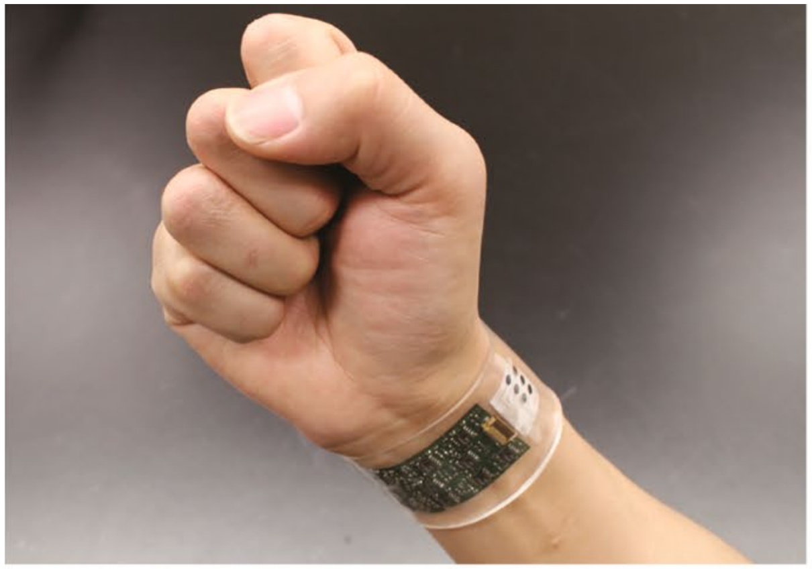
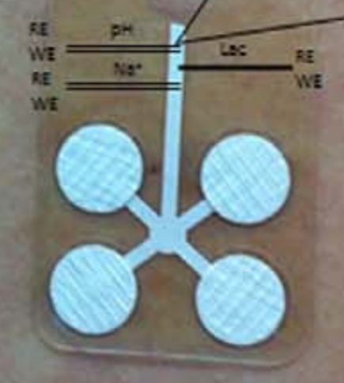


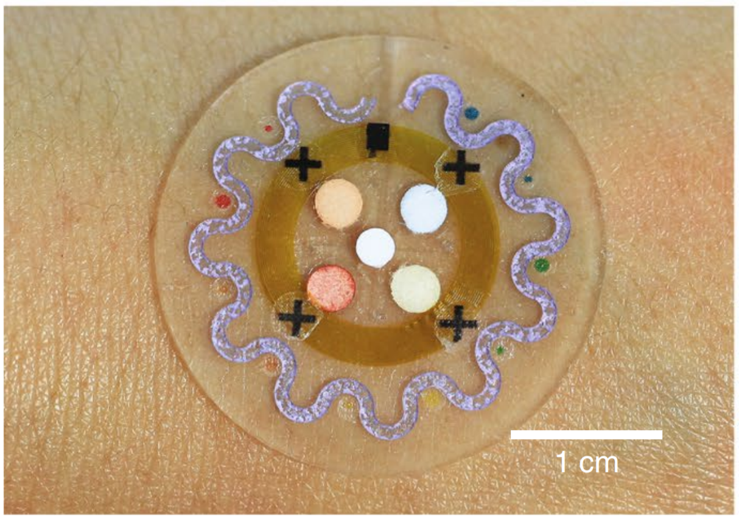
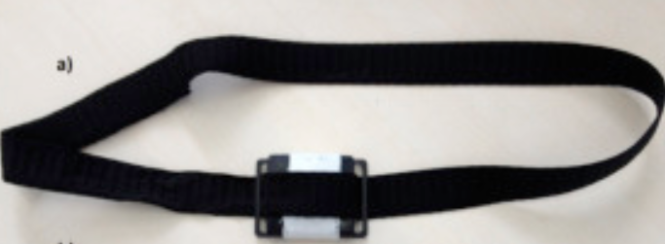
Recent wearable sweat pH sensors
L’Oreal’s skin track pH microfluidic wearable
Real-time,
Continuous
Long-term Reusable
A multiplexed electrochemical system for continuous monitoring of a panel of analytes (pH, Na+, K, Cl-) in sweat, integrated into a ‘smart’ wristband for fitness monitoring. [1]
IrOx pH sensor membrane [2]
Compatible with existing fitness trackers/
smart watches
Optical monitoring of sweat pH by a textile fabric wearable sensor [4]
One-time, colourimetric detection of sweat analytes (including pH) with microfluidic device[3]
1. Gao, Wei, et al. "Fully integrated wearable sensor arrays for multiplexed in situ perspiration analysis." Nature 529.7587 (2016): 509.
2.. Anastasova, S., Crewther, B., Bembnowicz, P., Curto, V., Ip, H. M., Rosa, B., & Yang, G. Z. (2017). A wearable multisensing patch for continuous sweat monitoring. Biosensors and Bioelectronics, 93, 139-145.
3/. Koh, Ahyeon, et al. "A soft, wearable microfluidic device for the capture, storage, and colorimetric sensing of sweat." Science translational medicine8.366 (2016): 366ra165-366ra165.
4/. Caldara, Michele, et al. "Optical monitoring of sweat pH by a textile fabric wearable sensor based on covalently bonded litmus-3-glycidoxypropyltrimethoxysilane coating." Sensors and Actuators B: Chemical 222 (2016): 213-220.
Notes:
Electro chemical, flexible circuit board with signal processing electronics – ECS cannot last beyond 10 days. (Ali Javey Berkeley’s group)
2. disposable: once use – medical ok, not fitness
3. Koh: microfluidic: sweat reacts with the chemicals – so have to replace the chemical reagents periodically. Non reusable
4. Caldara: electronics embedded inside the textile: can only be washed and reused for a short time of 15 days.
L’Oreal’s first commercial product

Slide 6
pH Watch
First ever wearable prototype leveraging pulse oximeters for reusable, real-time monitoring of pH value in sweat.
Real-time,
continuous
Long-term Reusable
Compatible with existing
Fitness trackers/ smart watches
Notes:
First Wearable prototype using pulse oximeters in exiting wearables, fitness trackers, smart watches to detect pH from sweat.
Low –cost, real-time, reusable and Compatible with many existing fitness trackers/ smart watches

Slide 7
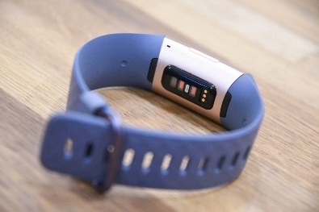
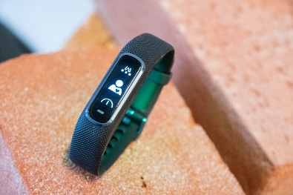
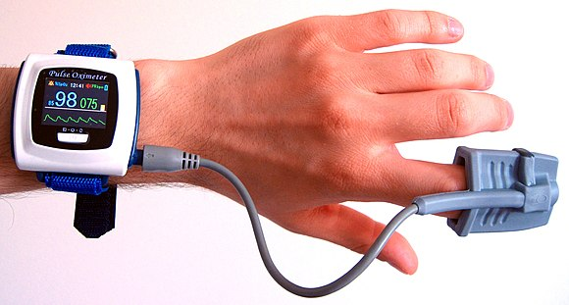
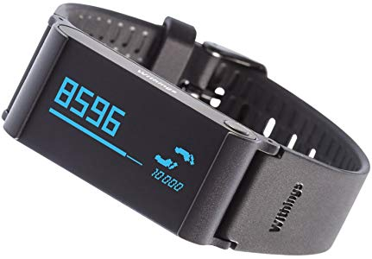
Pulse oximeters
Used for non-invasive monitoring of heart rate and oxygen saturation (SpO2)
Found in many existing smart watches and fitness trackers.
Fitbit charge 3
Garmin Vivosmart 4
Withings Pulse O2
Image Source : https://upload.wikimedia.org/wikipedia/commons/thumb/7/7d/Wrist-oximeter.jpg/580px-Wrist-oximeter.jpg
Notes:
Pulse oximeters can measure blood oxygen saturation and heart rate . Finger pulse oximeters are used in hospitals to measure oxygen concentration. But Good news is they can also be used with wrist and are already found in many existing fitness trackers such as fitbit charge 3, garmin vivosmart 4 and withings pulse o2.

Slide 8
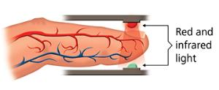
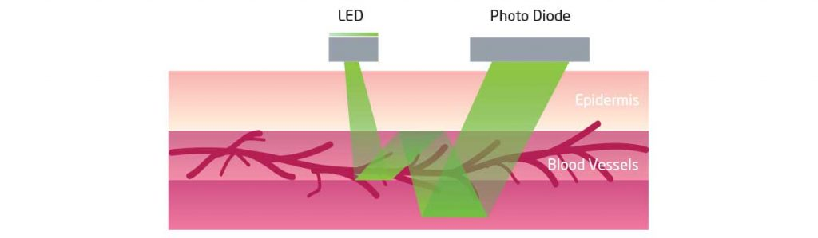
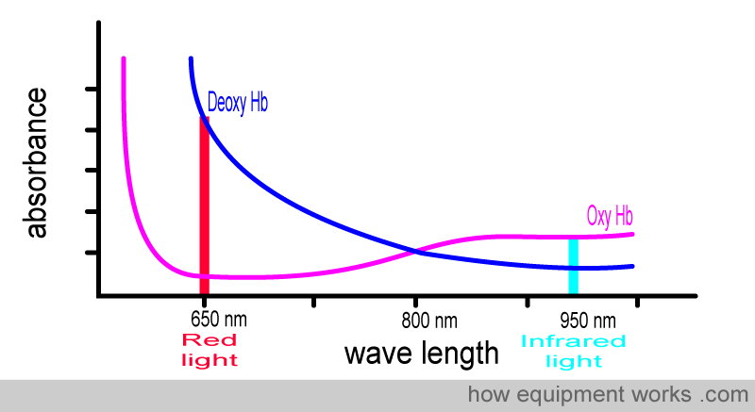
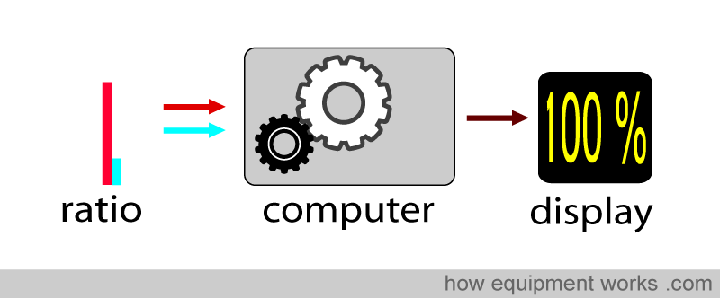
How a pulse oximeter works
Measures oxygen saturation
Shines light (Red(660nm) and Infrared (880nm) wavelengths) through your finger.
Sensors detect how much oxygen is in your blood based on the way the light passes through your finger. (Photoplethysmlograph – PPG)
Image Source: https://asiaweb.worldgn.com/science/technology/
Red absorbs more deoxy Hb than oxy Hb
IR absorbs more oxy Hb

Slide 9
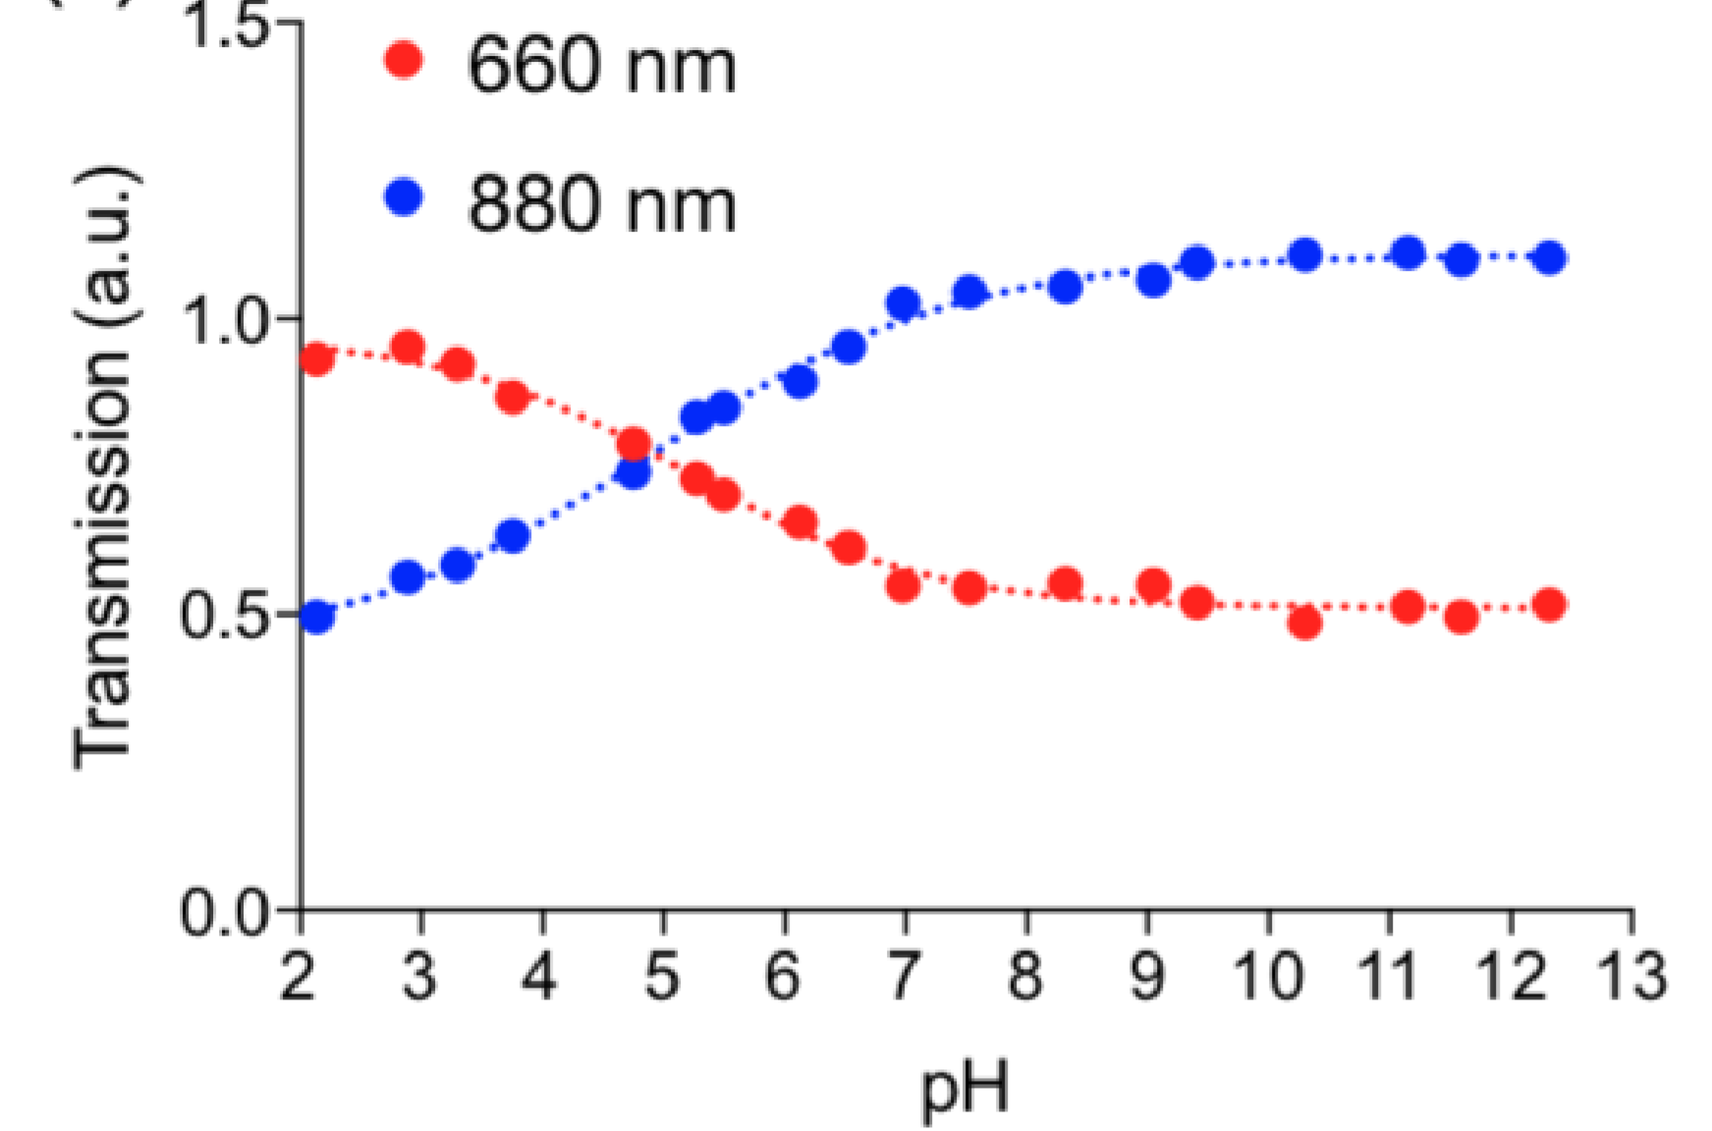
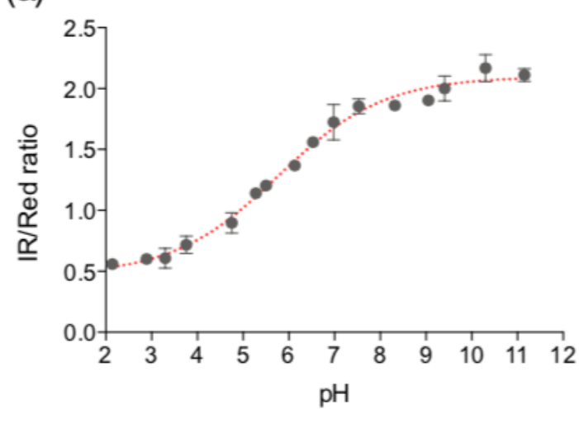
pH Watch’s flexible polyaniline (PANI) pH sensor
Infrared
PANI film sits between skin and pulse oximeter
Acidic (low pH):
polymer becomes protonated.
strong transmission of red light at 660 nm and
strong absorbance of IR light at 880 nm.
Alkaline (high pH):
polymer becomes deprotonated
absorbs strongly red light at 660 nm and
transmits most of IR light at 880 nm.
Red
Low cost of only ~1$ for manufacturing PANI pH sensor.
Biocompatible and does not disintegrate.

Slide 10
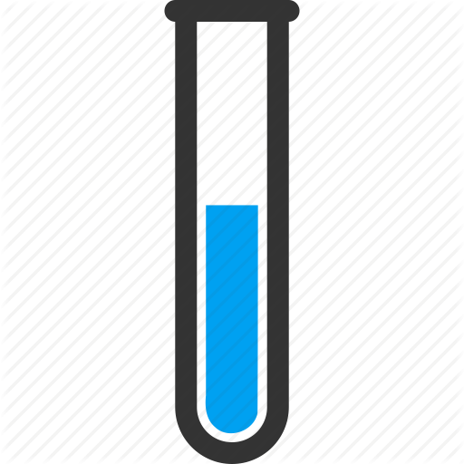
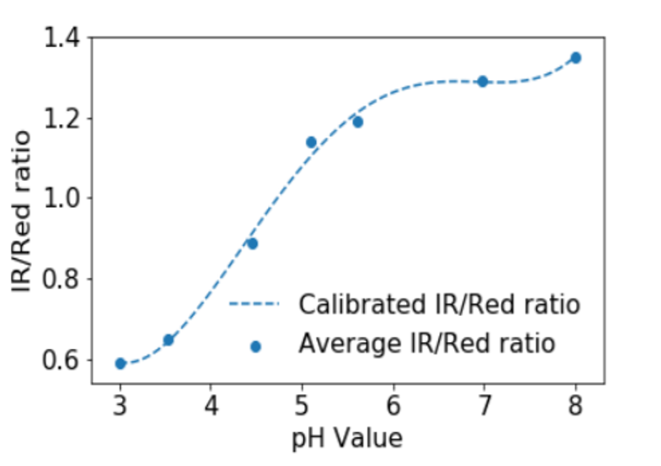
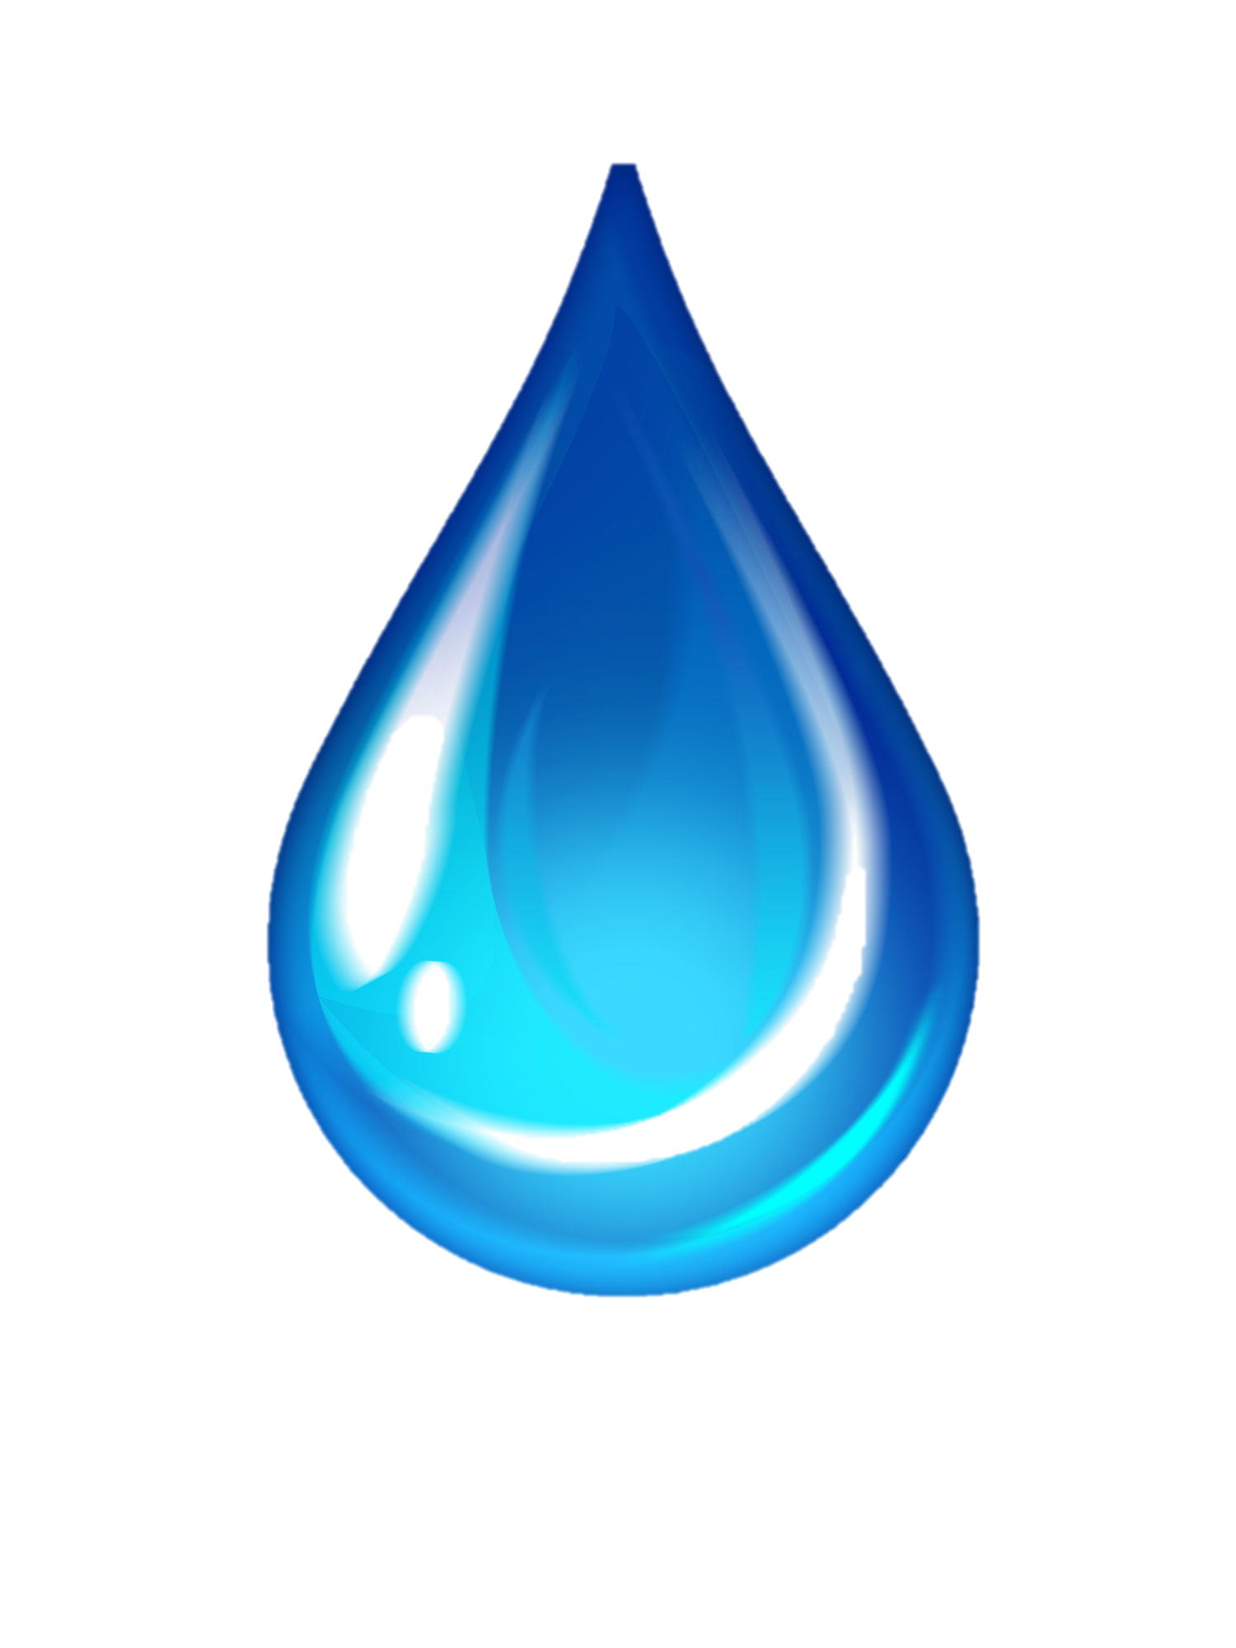
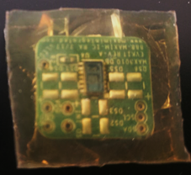
MAX30101 IR-to-Red ratio calibration
Synthetic sweat solutions of different pH
IR and Red values measured from MAX30101
200 μL
MAX30101 mounted with PANI

Slide 11
High-level overview of pH Watch
Pulse Oximeter Mounted with PANI
CC2650 SensorTag MCU for collection and processing the PPG signals
pH Sensing approach
Motion artefact removal from PPG signals
pH,HR, SpO2 Estimation

Slide 12
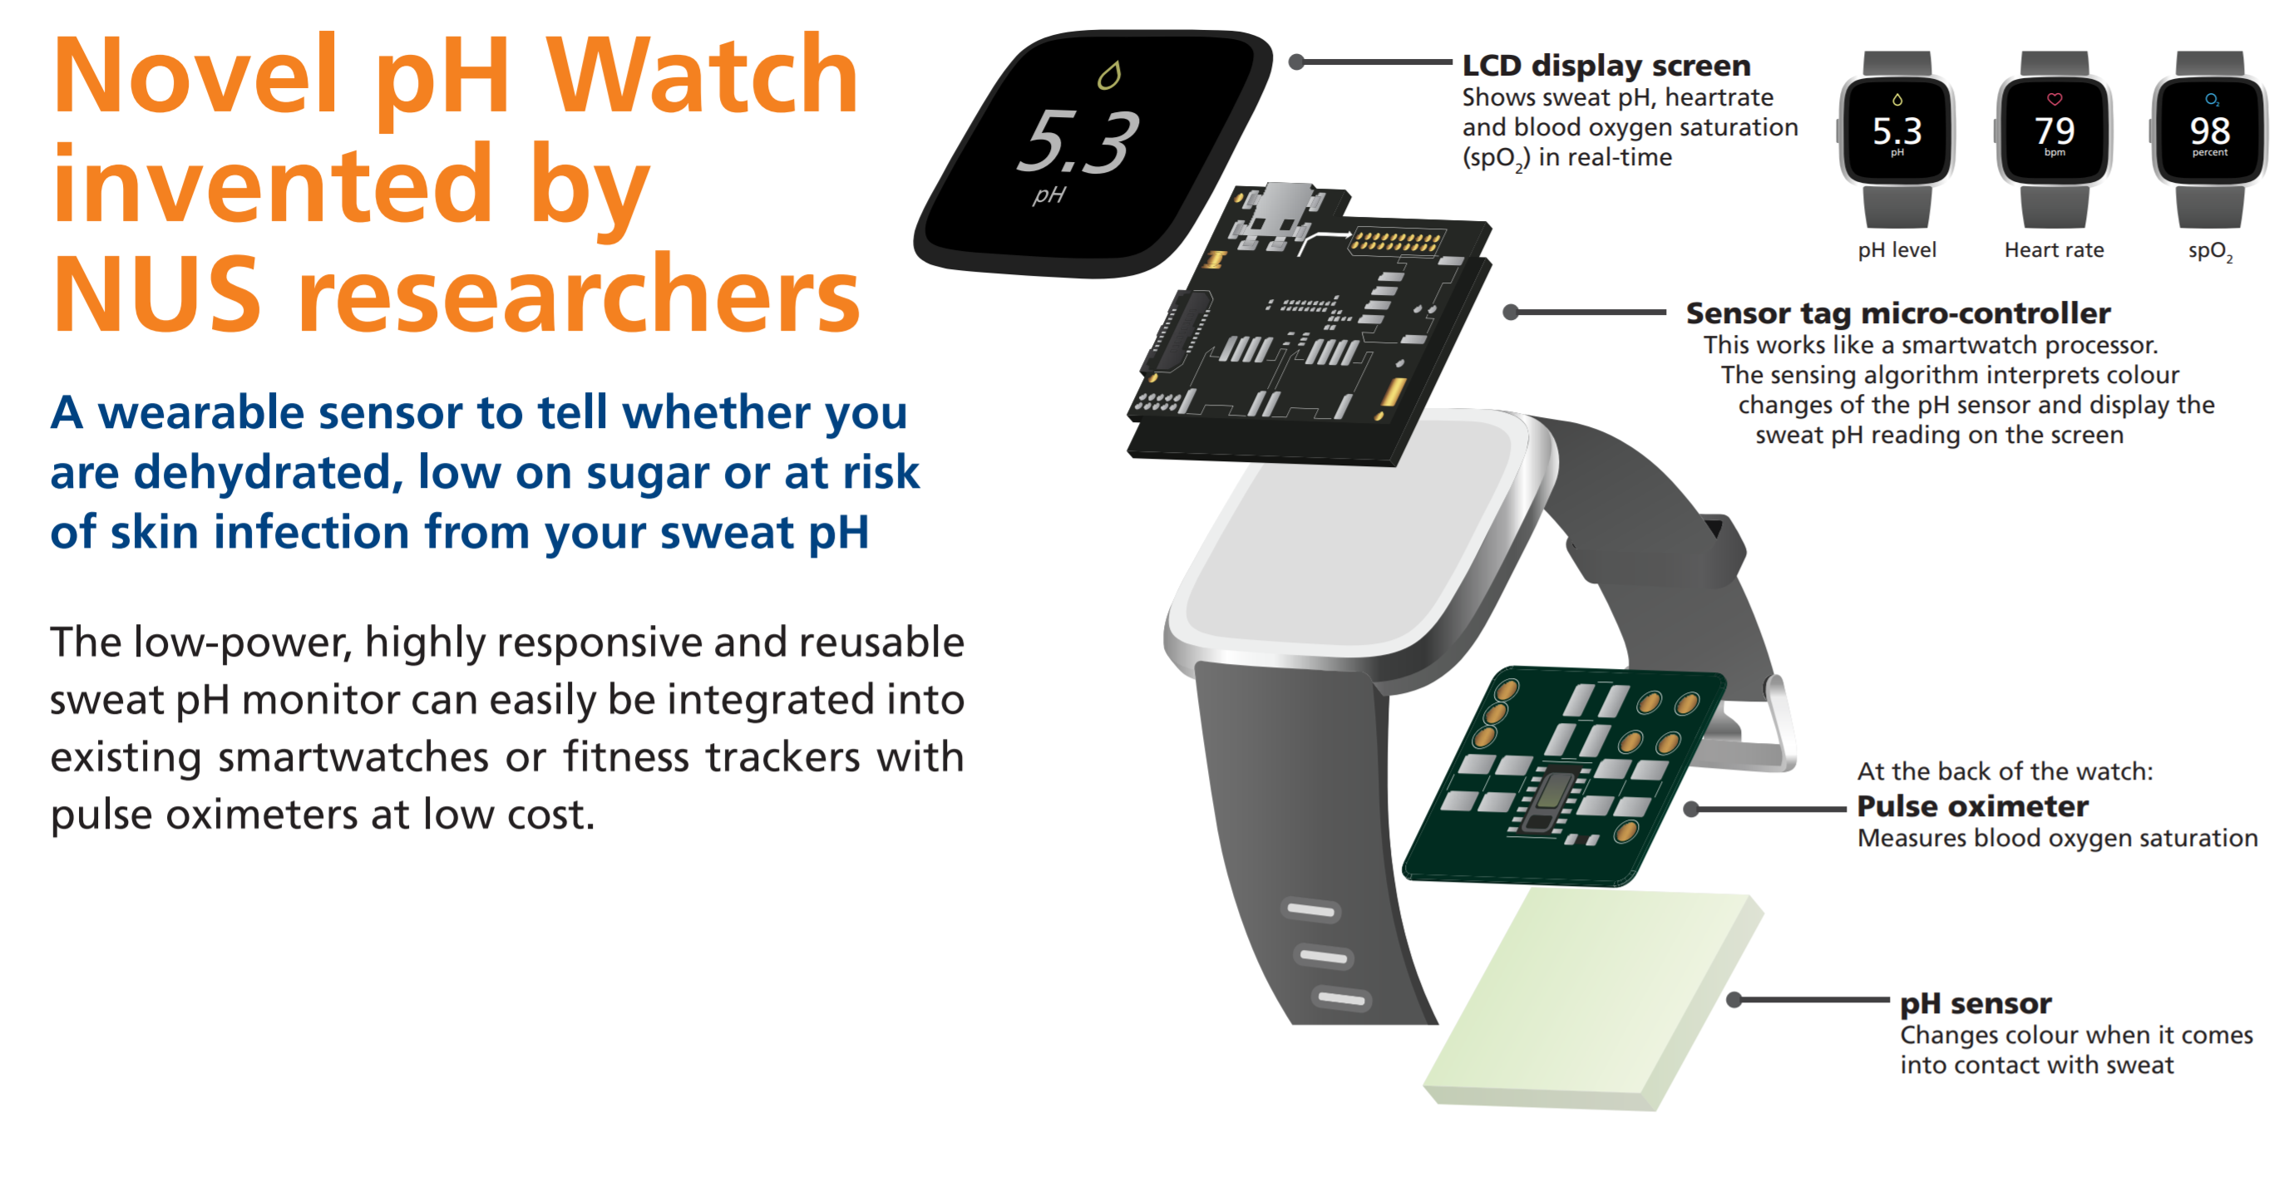
System Prototype of pH Watch

Slide 13
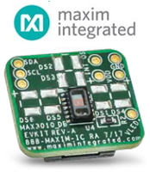
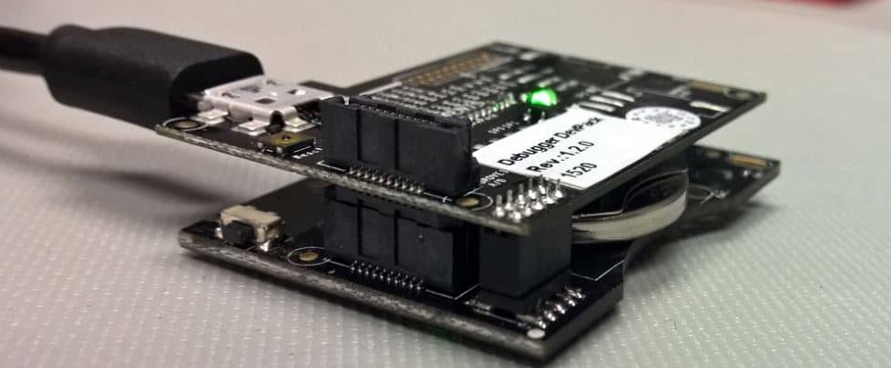
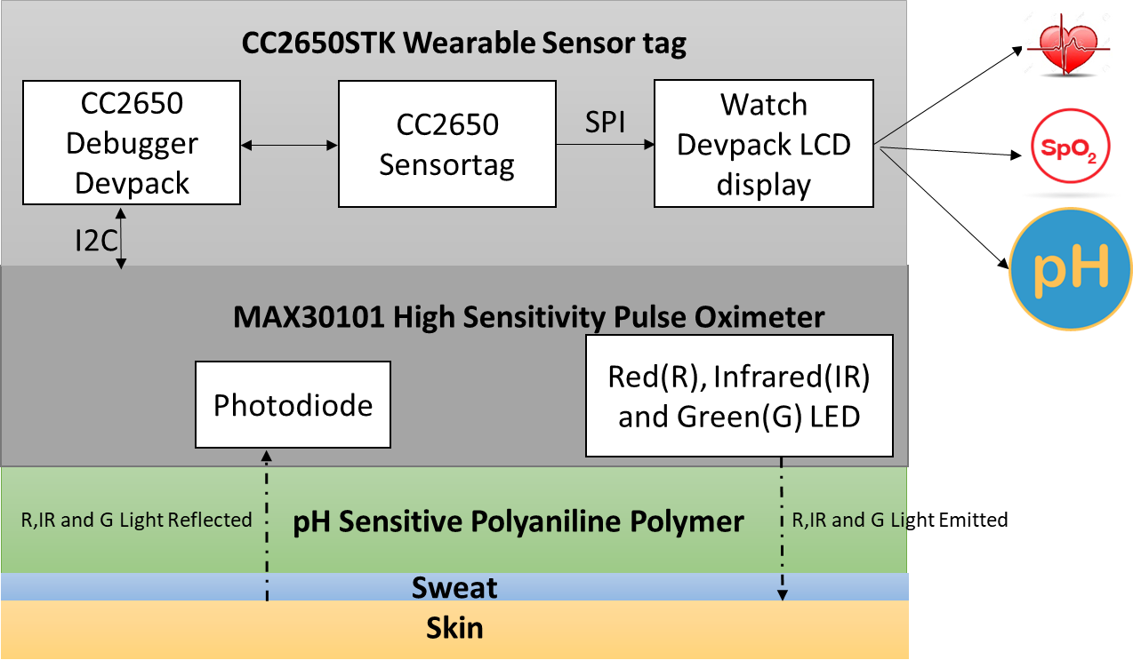
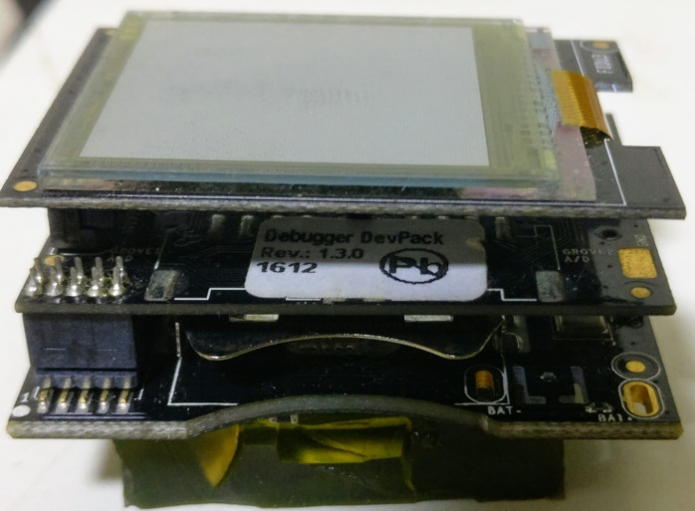
System Prototype of pH watch
MAX30101
MAX30101 mounted with PANI
CC2650 MCU + Sensor Tag
Watch Devpack
LCD Display
Debugger Devpack
CC2650 Wearable
Sensor tag
MAX30101 covered
with pH sensitive PANI

Slide 14
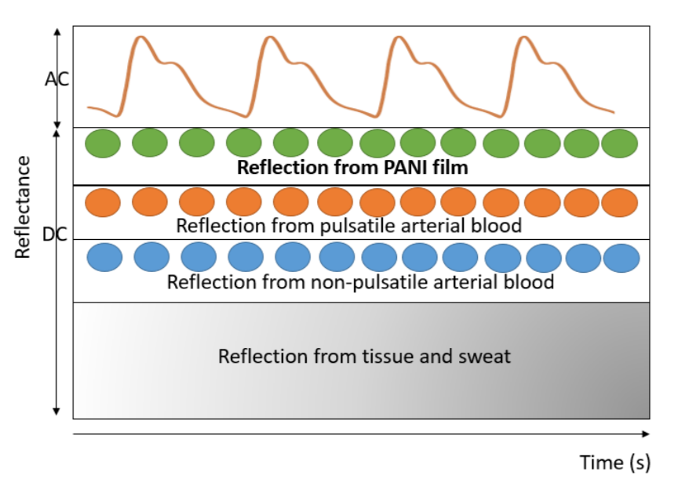
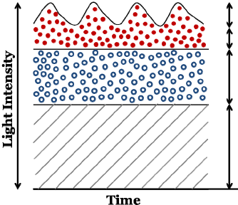
Our pH sensing algorithm
PPG signal reflected from a pulse oximeter

Slide 15
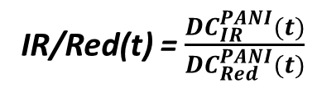

Our pH sensing algorithm
DC^{PANI}
DC^{PANI}(t)
=
DC(t) - DC^{INIT}
DC^{INIT}
DC^{INIT}
$$⇒$$
IR/Red(t) = $\frac{{DC}_{IR}^{PANI}(t)}{{DC}_{Red}^{PANI}(t)}$
DC components reflected from the skin, tissue, fat, bones etc. remain constant over time.
Mean of DC PPG signal for first 3 seconds

Slide 16
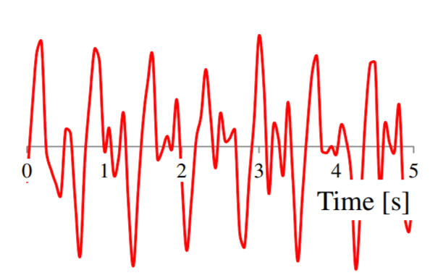

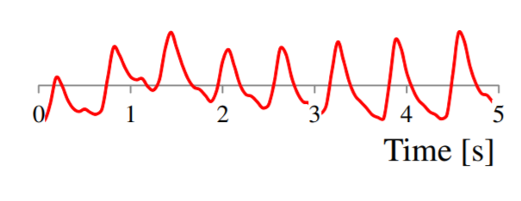

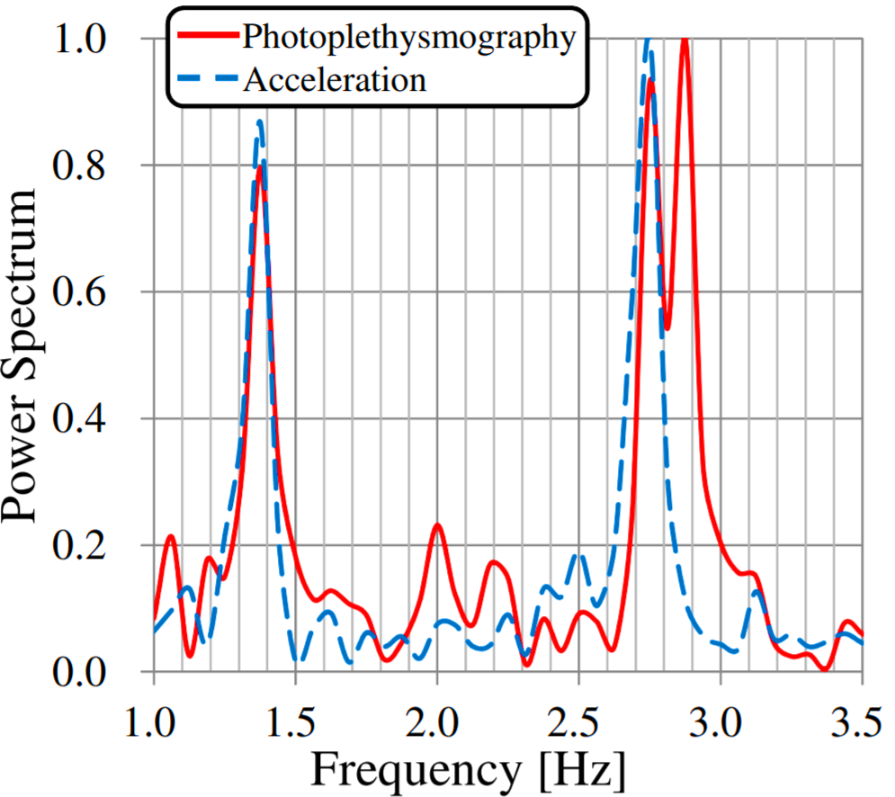
Heart rate measurement
- Addition of PANI does not hinder pulse oximeter’s capacity to measure heart rate.
- HR is affected by motion artefacts.
Heart rate
CC2650 Sensor Tag
1. Accelerometer frequency
2. PPG Heart rate frequency (BPM)
Occurs close to each other
MAX30101
Image Source : Fukushima, Hayato, et al. "Estimating heart rate using wrist-type photoplethysmography and acceleration sensor while running." 2012 Annual International Conference of the IEEE Engineering in Medicine and Biology Society. IEEE, 2012.

Slide 17
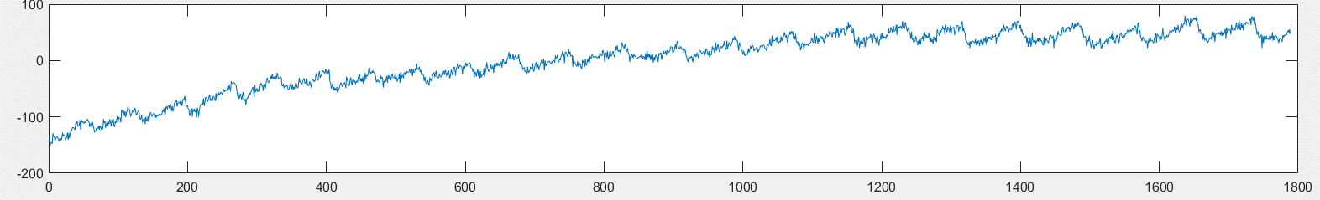
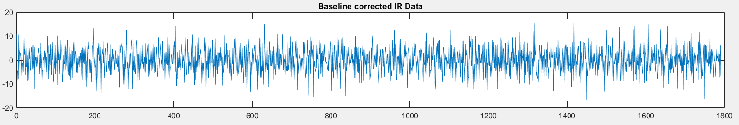
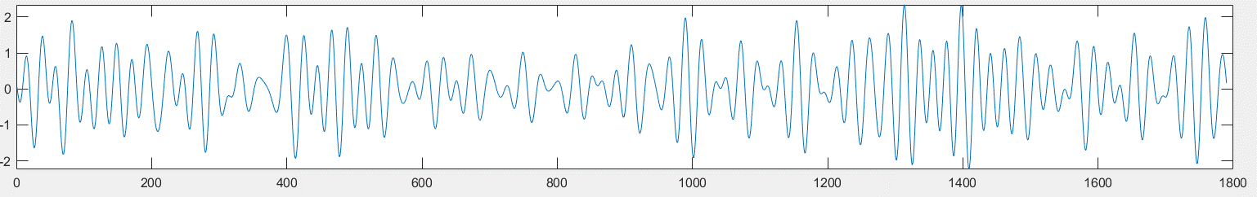
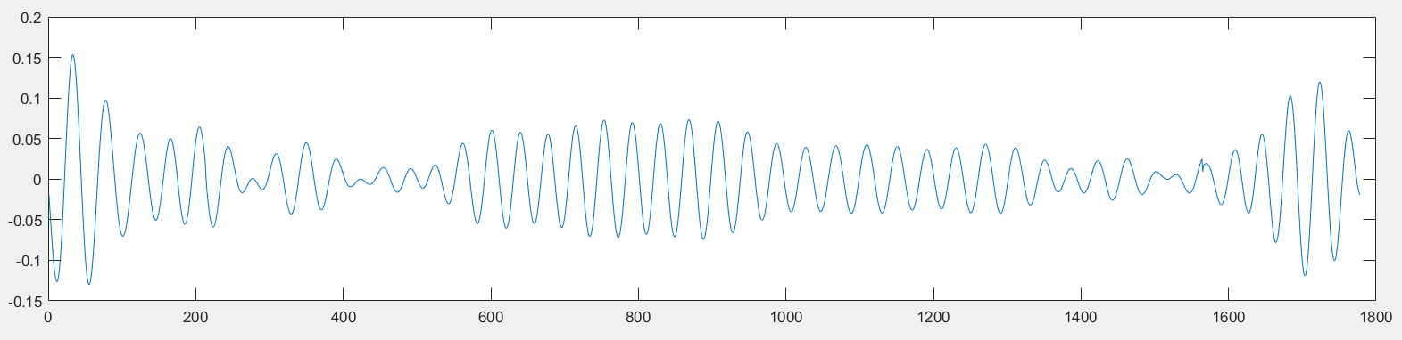
TROIKA Motion Artifact removal algorithm [Z. Zhang et al.]
Signal decomposition
Sparse signal reconstruction
Spectral peak tracking and verification
Removes overlapping motion artefact frequencies between PPG and accelerometer
Sparsifies the PPG spectrum resulting in a high resolution spectrum
Selects spectral peak that corresponds to HR (rejects non-existent heart rate peak)
Raw Green PPG Signal with MA
DC Removal
Band Pass Filter
[0.4 – 4Hz]
PPG after
TROIKA
MA removal

Slide 18
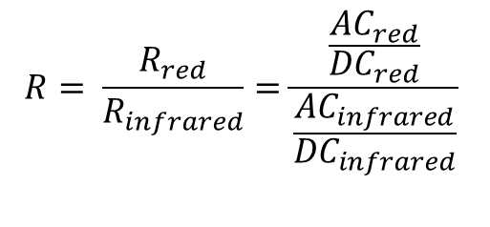
SpO2 measurements
$$R= \frac{R_{red}}{R_{infrared}}=\frac{\frac{{AC}_{red}}{{DC}_{red}}}{\frac{{AC}_{infrared}}{{DC}_{infrared}}}$$
Cleansed AC PPG signal obtained from TROIKA
The scattering constant and the optical path length vary considerably between the red and infrared wavelength. R ≠ SpO2
Experimental Calibration to relate R and SpO2. For MAX30101, SpO2 = 104-17R

Slide 19
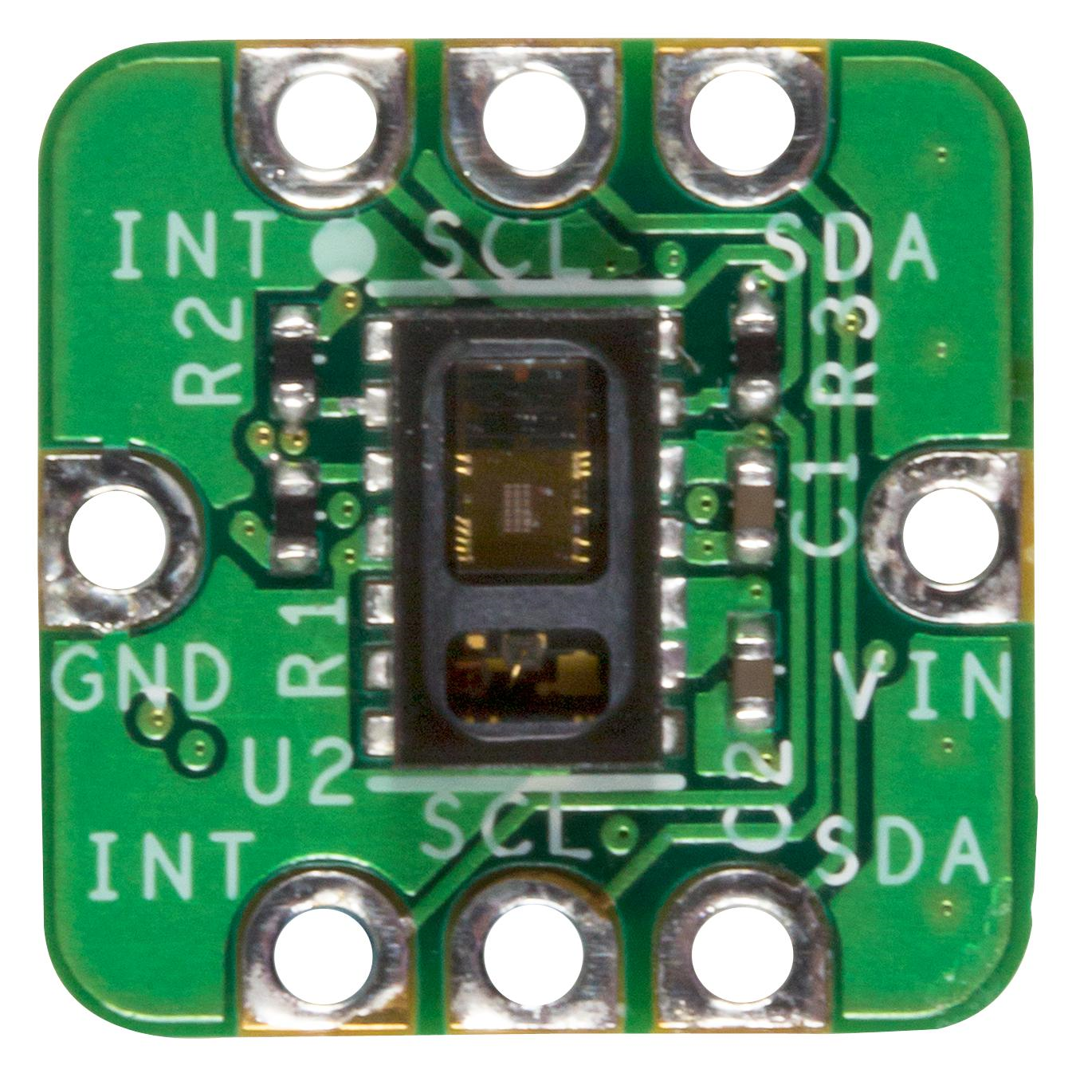
Experiments – Heart Rate
Experimental Setup
Single Participant asked to wear pH Watch
1. Experiments without any hand motion
Each Trial ⇒ 120 Seconds
 | Trial 1 | Trial 2 | Trial 3 | Trial 4 | Trial 5 | Trial 6 | Trial 7 | Trial 8
True BPM | 86 | 84 | 83 | 82 | 75 | 84 | 87 | 73
Estimated BPM | 85 | 82 | 85 | 83 | 74 | 83 | 84 | 73
Error (%) | 1.16 | 2.38 | 2.35 | 1.20 | 1.33 | 1.19 | 3.44 | 0
Mean Error (%) | 1.22
pH Watch HR measurements
HR Ground truth
MAX30102 Finger Pulse oximeter

Slide 20

Experiments – Heart Rate
2. Experiments with random hand motions
Right Hand – pH Watch
Each Trial ⇒ 120 Seconds
Left Hand –
Stationary
 | Trial 1 | Trial 2 | Trial 3 | Trial 4 | Trial 5 | Trial 6 | Trial 7 | Trial 8
True BPM | 83 | 82 | 81 | 80 | 79 | 78 | 70 | 73
Estimated BPM | 88 | 78 | 86 | 76 | 75 | 81 | 72 | 78
Error (%) | 5.68 | 4.87 | 5.8 | 5.26 | 5.33 | 3.7 | 2.78 | 6.41
Mean Error (%) | 4.98
random hand motions
HR Ground truth
MAX30102 Finger Pulse oximeter
pH Watch HR measurements

Slide 21
Experiments – SpO2
1. Experiments without any hand motion
Each Trial ⇒ 120 Seconds
 | Trial 1 | Trial 2 | Trial 3 | Trial 4 | Trial 5 | Trial 6 | Trial 7 | Trial 8
True BPM | 95 | 94 | 97 | 98 | 95.5 | 96 | 98 | 93
Estimated BPM | 92.5 | 91 | 94 | 95 | 93 | 94 | 96 | 91
Error (%) | 2.63 | 3.2 | 3.1 | 3.06 | 2.61 | 2.1 | 2.04 | 3.22
Mean Error (%) | 2.75
SpO2 Ground truth
MAX30102 Finger Pulse oximeter
pH Watch SpO2 measurements

Slide 22
Experiments – SpO2
2. Experiments random hand motions
Right Hand – pH Watch
Each Trial ⇒ 120 Seconds
Left Hand –
Stationary
 | Trial 1 | Trial 2 | Trial 3 | Trial 4 | Trial 5 | Trial 6 | Trial 7 | Trial 8
True BPM | 98 | 97 | 96 | 94 | 95 | 95 | 92 | 90
Estimated BPM | 93.5 | 92 | 93 | 89 | 91 | 90 | 94.5 | 96.5
Error (%) | 4.59 | 5.15 | 3.2 | 5.32 | 4.21 | 5.26 | 2.12 | 6.73
Mean Error (%) | 4.57
SpO2 Ground truth
MAX30102 Finger Pulse oximeter
pH Watch SpO2 measurements

Slide 23
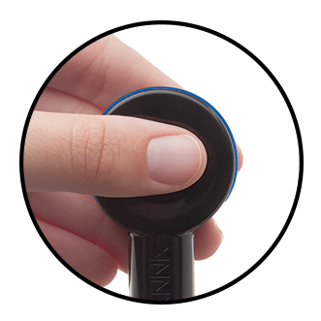
Experiments – pH measurement
6 participants
10-20 minutes of exercise ⇒ sweating
⇒ pH value measured by pH Watch – Trial repeated two times for each participant
pH Ground truth
HALO Wireless pH Meter
True pH | 4.28 | 4.29 | 4.78 | 4.86 | 5 | 5.15 | 5.4 | 5.53 | 5.6 | 5.76 | 6.43 | 6.82
pH Watch | 4.36 | 4.33 | 4.87 | 5.02 | 4.98 | 5.35 | 5.36 | 5.61 | 5.82 | 5.52 | 6.27 | 7.01
Error (%) | 1.8 | 0.9 | 1.9 | 3.3 | 0.4 | 3.8 | 0.7 | 1.4 | 3.93 | 4.2 | 2.5 | 2.8
Average % Error | 2.31%
pH Watch - pH measurements

Slide 24
HR, Spo2 and pH Continuous Sensing Experiment
4 participants
Cycling for 80 minutes
Ground truth pH measured manually using HALO wireless pH meter manually every 5 minutes.
pH of sweat does not change rapidly within 5 minutes

Slide 25
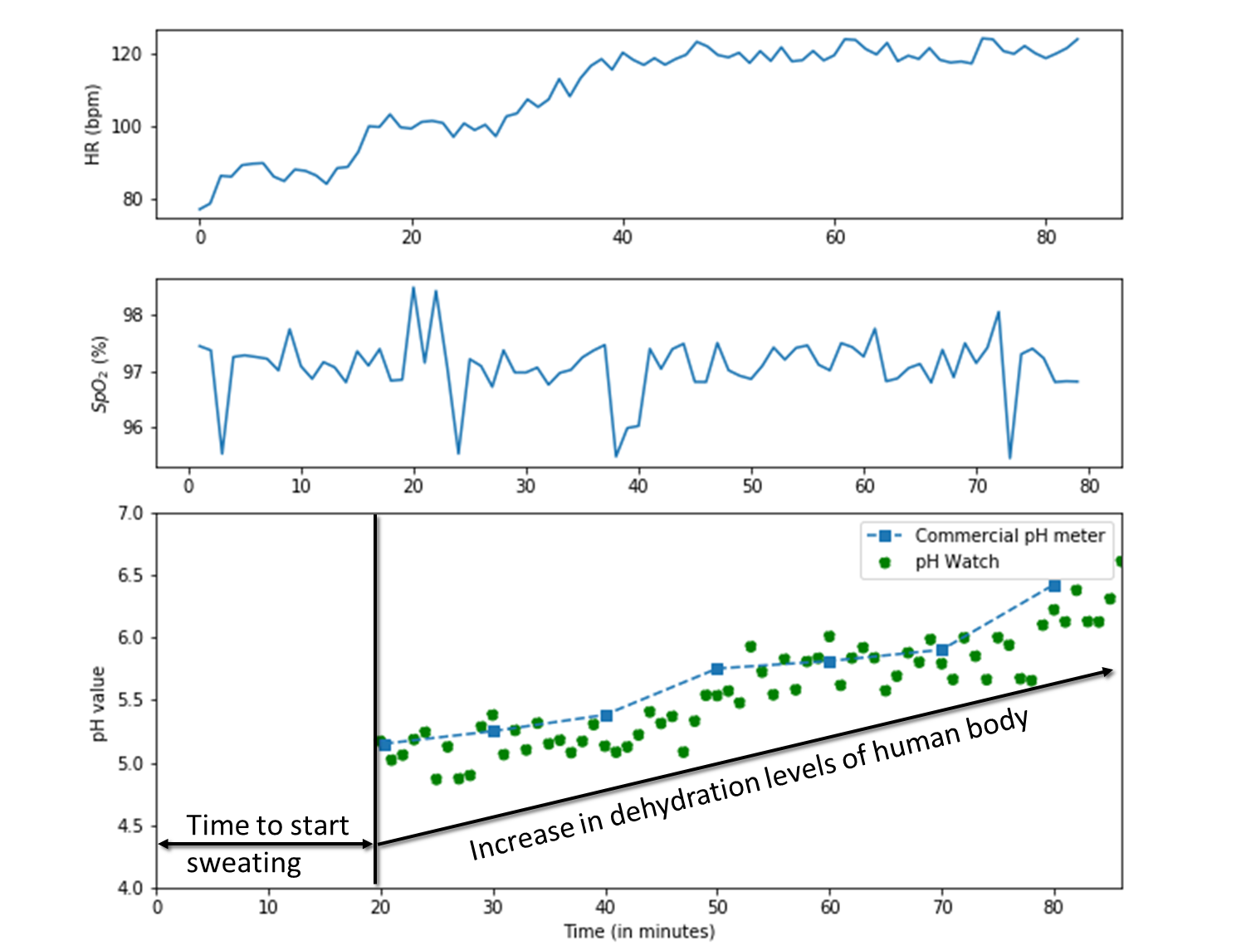
Continuous sensing - results

Slide 26
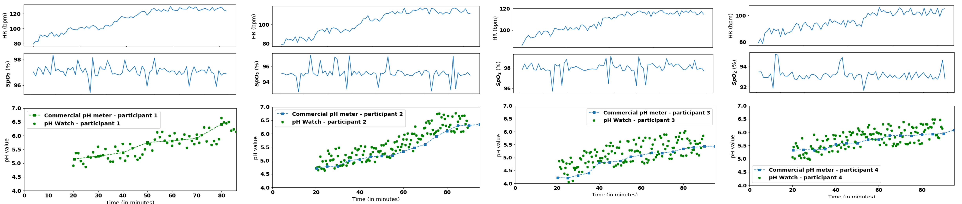
Continuous sensing - results
pH increases with exercise duration
- Indicates hydration levels
Maximum pH error of ± 0.6

Slide 27

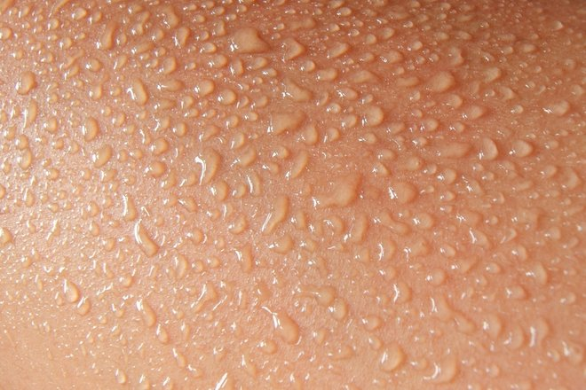
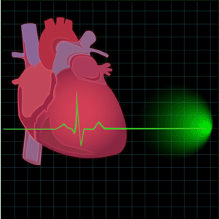

Limitations and Future Work
Limited Participant trials
Effect of sweat residue
SpO2 Errors ~ 7%
Dehydration risk
Image Source: https://www.alamy.com/stock-photo/cartoon-people-crowd.html

Slide 28
Conclusion
pH Watch – First ever off-the-shelf addition of PANI to leverage pulse oximeters in existing wearables for sensing pH value from sweat
Good pH sensing accuracy
Addition of PANI does not hinder HR and Spo2 measurements of pulse oximeter.
Low cost of ≈1 USD for manufacturing the PANI polymer.
Next goal: Data acquisition and analysis of patterns in pH values observed during exercise precisely predict dehydration risk
In talks with smart watch manufacturers to get our pH sensor into their watches

Slide 29


Slide 30
REFERENCES
1. Gao, Wei, et al. "Fully integrated wearable sensor arrays for multiplexed in situ perspiration analysis." Nature 529.7587 (2016): 509.
2.. Anastasova, S., Crewther, B., Bembnowicz, P., Curto, V., Ip, H. M., Rosa, B., & Yang, G. Z. (2017). A wearable multisensing patch for continuous sweat monitoring. Biosensors and Bioelectronics, 93, 139-145.
3/. Koh, Ahyeon, et al. "A soft, wearable microfluidic device for the capture, storage, and colorimetric sensing of sweat." Science translational medicine8.366 (2016): 366ra165-366ra165.
4/. Caldara, Michele, et al. "Optical monitoring of sweat pH by a textile fabric wearable sensor based on covalently bonded litmus-3-glycidoxypropyltrimethoxysilane coating." Sensors and Actuators B: Chemical 222 (2016): 213-220.

